Slide 1
Reflective Video (C Programming Concepts)
By: Jason Ang
COS10009 Introduction to Programming

Slide 2
Overview
1. Variables
2. Standard Input / Output
3. Selection
4. Loop
5. Array

Slide 3
Variables

Slide 4
Variables
In programming, data is stored in containers
The correct container must be used when assigning data.
Example: Gender and age
char gender;
int age;
gender = “M”;
age = 21;
Explanation:
char and int are the data containers for gender and age.
char only stores character type data (e.g. @, a, &).
int stores integer type data (e.g. 1, 22, 365).

Slide 5
Standard Input / Output

Slide 6
Standard Input / Output
Programming requires input and output.
Input uses scanf();
Output uses printf();
Example: Asking someone’s gender and age
char gender;
int age;
printf("What is your gender?");
scanf("%c", &gender);
printf("What is your age?");
scanf("%i", &age);
printf("Your gender is %c and you are %i years old", gender, age);

Slide 7

Result

Slide 8
Selection

Slide 9
Selection
Decision making situations
C uses if(), if else(), else
Example 1: Whether John needs to go to work
char sick;
printf("Is John sick?");
scanf("%c", &sick);
if (sick == 'Y')
{
printf("John does not need to go to work.");
}
else
{
printf("John needs to go to work.");
}

Slide 10


Result 1
Result 2

Slide 11
Selection (cont)
C also allows nested if else statements (an ‘if’ within another ‘if’).
Example 2: Whether John needs to go to work, and if he’s sick, goes to hospital or clinic
char sick;
char condition;
printf("Is John sick?");
scanf("%c", &sick);
if (sick == 'Y')
{
printf("John does not need to go to work.");
printf("\nIs John very sick?");
scanf("%c", &condition);
if (condition == 'Y')
{
printf("John needs to go to a hospital.");
}
*Coding continues next page*

Slide 12
*Here*
else
{
printf("John can go to a hospital or a clinic.");
}
}
else
{
printf("John needs to go to work.");
}
Note:
- “\n” makes whatever comes after it move to a new line.

Slide 13


Result 1
Result 2

Slide 14
Loop

Slide 15
Loop
Used for executing the same action a number of times
E.g. checking a condition until it is true or false
while(), for()
Example: Guessing a random number
int rand_x;
int input;
int d = 0; /* To initialise loop */
srand( (unsigned) time(NULL));
rand_x = rand()%101;
while (d < 1)
{
printf("\nGuess the random number between 0 to 100:");
scanf("%i", &input);
if (input > rand_x)
printf("The guessed number is larger than the random number.");
*Coding continues next page*

Slide 16
*Here*
else if (input < rand_x)
printf("The guessed number is lesser than the random number.");
else
{
printf("Congratulations! You've guessed it right! The random number is indeed %i.", rand_x);
break;
}
}
Note:
“srand( (unsigned) time(NULL));” generates a random number. “rand_x = rand()%101;” ensures that the random number is not the same every time you run the program.
“break;” breaks the loop.

Slide 17
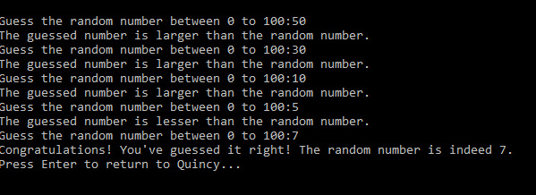
Result

Slide 18
Array

Slide 19
Arrays
Similar to a variable, only difference is that you add a “[]” behind the variable name
E.g. int array[10];
An array’s first position is 0, not 1.
Loops are commonly used when dealing with arrays.
Example: Printing number 1 to 20 and printing one specific number
int array[20];
int counter;
int plus = 1;
for(counter = 0; counter <= 19; counter++)
{
array[counter] = plus;
printf("\n%i", array[counter]);
plus++;
}
printf("\nThe number in the 6th position in the array is %i", array[5]);

Slide 20
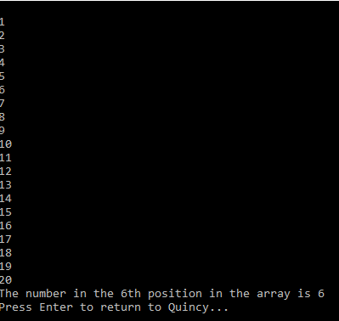
Result

